Slide 1

Angiosperms
(estimated 257,400 angiosperm species in 13,678 genera)
Basal Angiosperms: The ANA (used to be ANITA) Grade
(Amborella, Nymphaeales, (Illiciaceae, Trimeniaceae) and Austrobaileyaceae)
Judd et al pp. 235-249

Slide 2
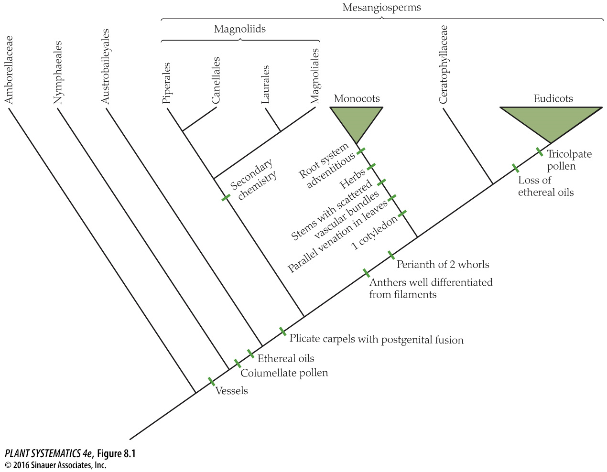
ANA Grade

Slide 3
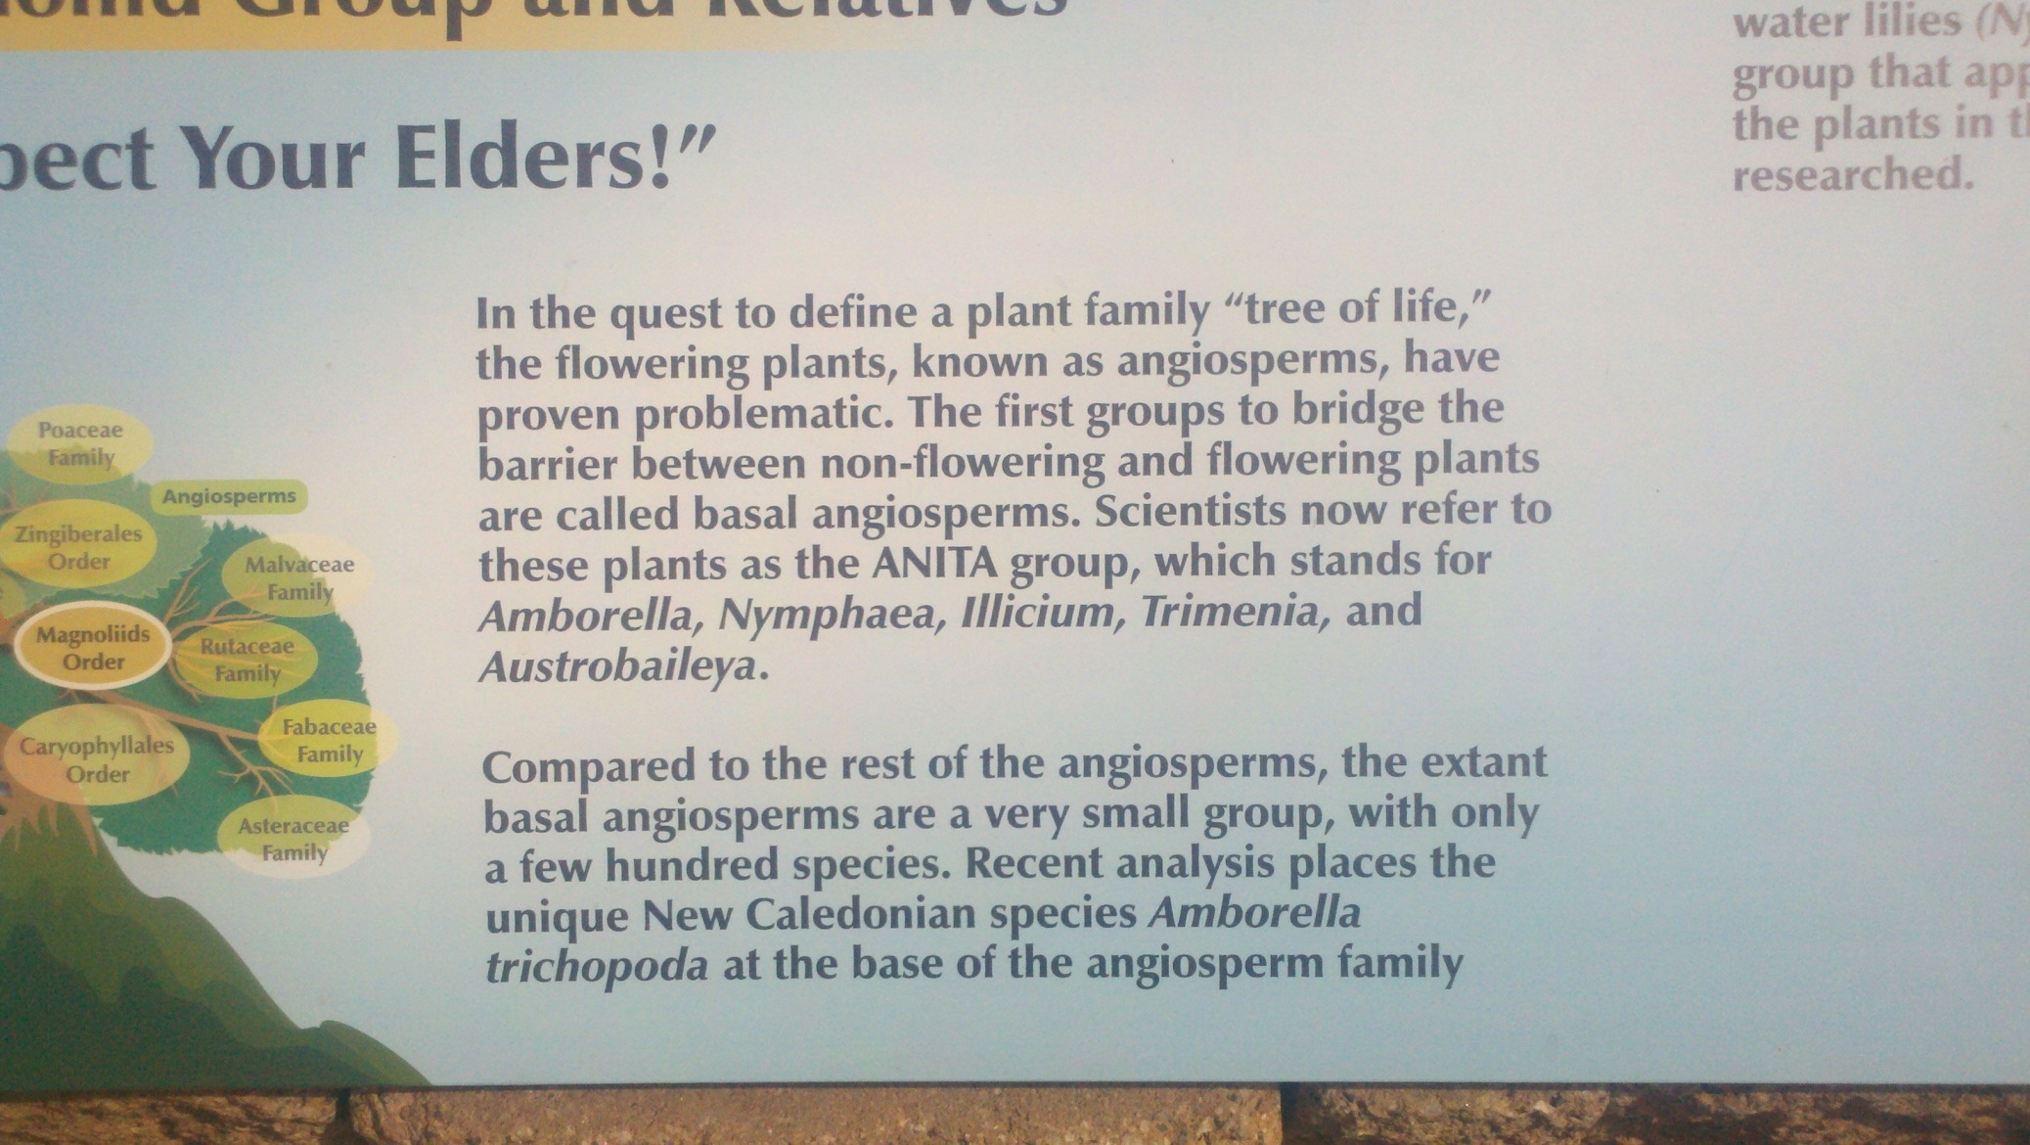

Slide 4
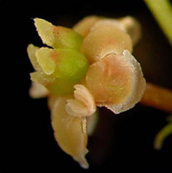
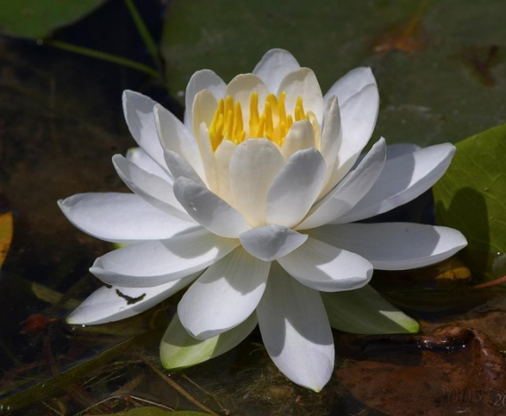
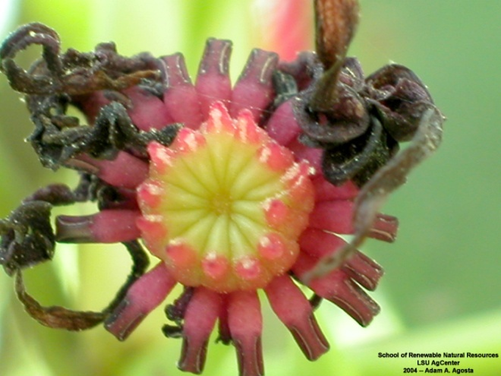
“ANA GRADE”

Slide 5
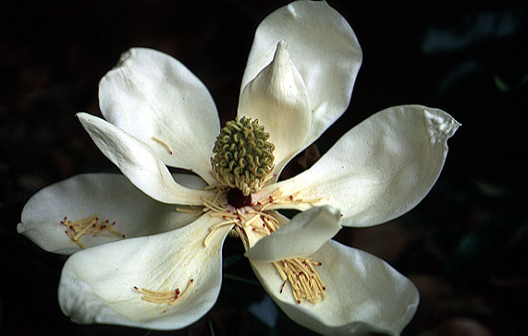
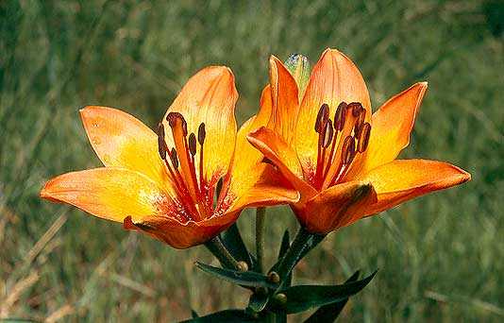
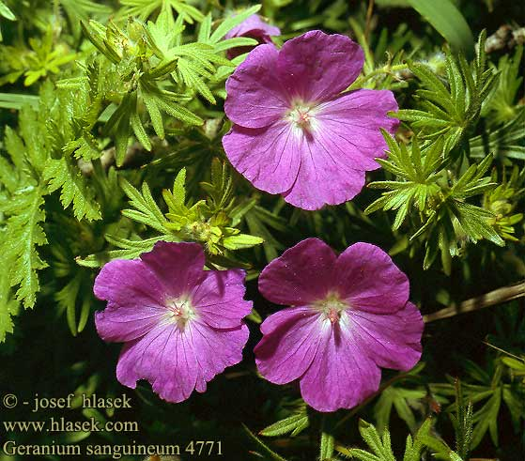
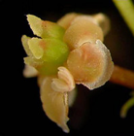


Magnoliids
Monocots
Amborella
Nymphaeles
Austrobaileyales
{
Eudicots
Mesangiosperms
ANA Grade

Slide 6
Angiosperm Synapomorphies
Seeds produced within a carpel with a stigmatic surface for pollen germination
Very reduced female gametophyte, consisting in most cases of just 8 nuclei in seven cells
Double fertilization
Triploid endosperm
Specialized phloem (companion cells derived from same mother cell as sieve tube elements)– though very similar to gymnosperms. Sieve tube elements are living but have no nucleus. Gymnosperms have sieve pores, while angiosperms have sieve plates.

Slide 7
Angiosperm Synapomorphies
Vessels in xylem tissue (not just tracheids; this feature probably evolved within the group however– no vessels in Amborella)
Many molecular features as well.

Slide 8
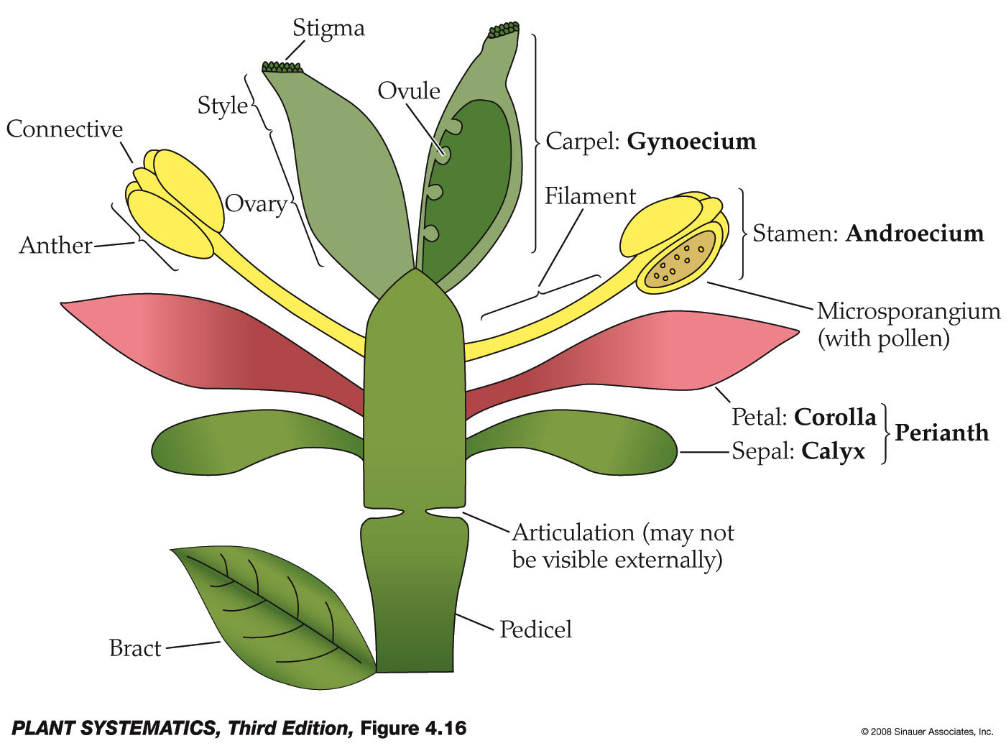
Generalized Flower Parts

Slide 9
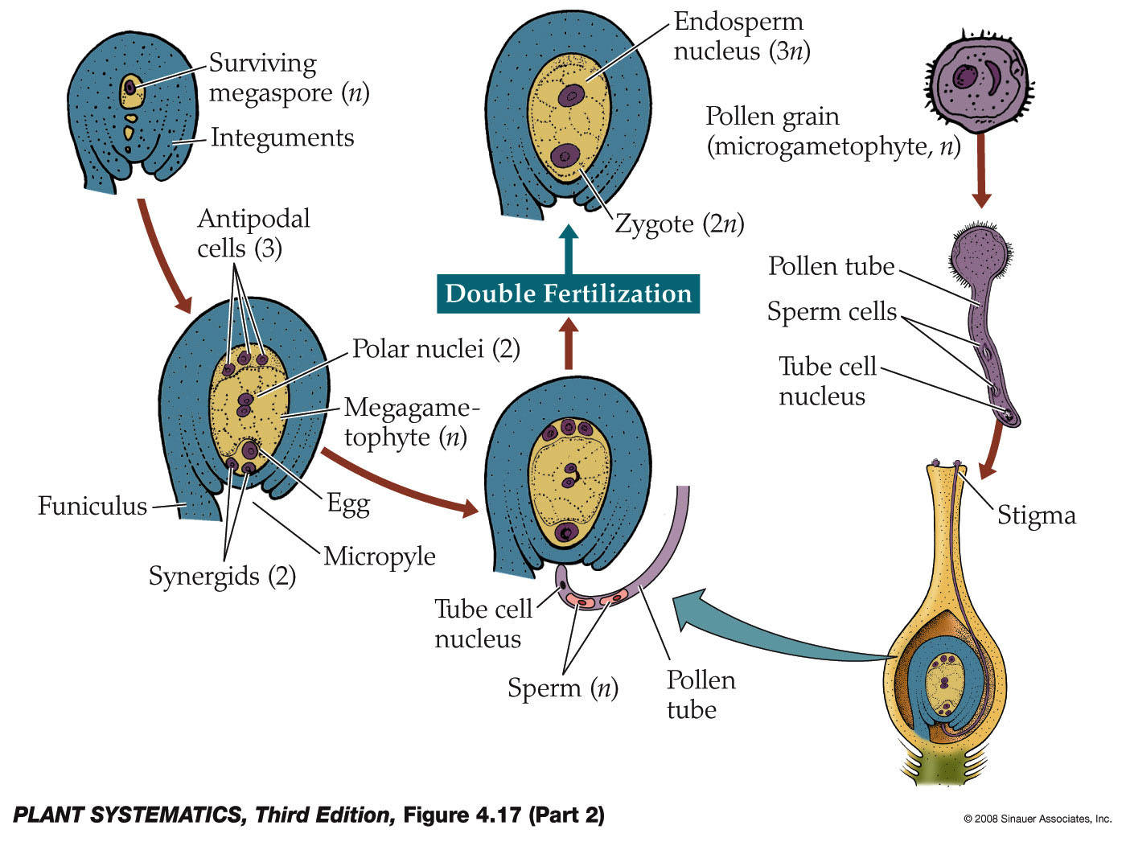
Angiosperm Life Cycle
Gametophyte of “typical” angiosperms usually has 8 nuclei in 7 cells.

Slide 10
Flowers of Early Angiosperms
(as judged by the ANA Grade)
Insect pollinated
Radially symmetrical
Bisexual (although not Amborella) and hypogynous
Parts several to numerous
Parts free and distinct
Perianth poorly differentiated into calyx and corolla (i.e., with tepals)
Stamens poorly differentiated into anthers and filaments

Slide 11
Flowers of Early Angiosperms
(as judged by the ANA Grade)
Pollen grains monosulcate
Carpels with poorly differentiated stigma and style
Carpel margins sealed by a secretion rather than fusion of epidermal layers as in other angiosperms.
Female gametophyte may have unusual numbers of cells and ploidy level of endosperm: most other angiosperms have an 8-nucleate female gametophyte and triploid endosperm

Slide 12
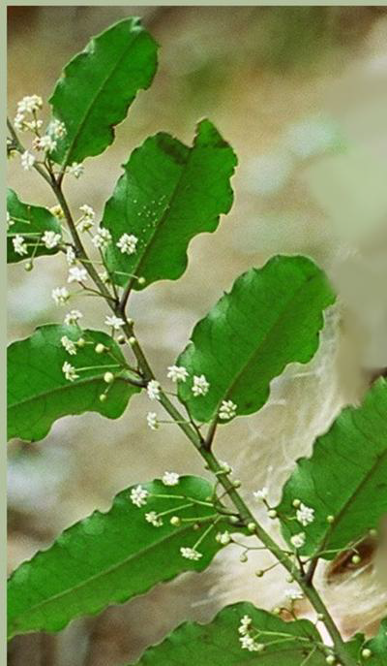

Amborella trichopoda

Slide 13

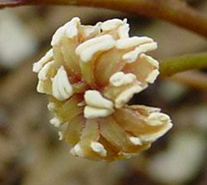

Amborella trichopoda: flower
Lacks vessels in xylem
9-nucleate female gametophyte and triploid endosperm
Shrub
Stigma and style poorly differentiated
Flowers unisexual, carpellate flowers have sterile stamens
(staminodes)
Tepals= no differentiation into sepals and petals
Stamens poorly delimited
between anther and filament
(filament short); inner
stamens frequently sterile
(staminodes)

Slide 14
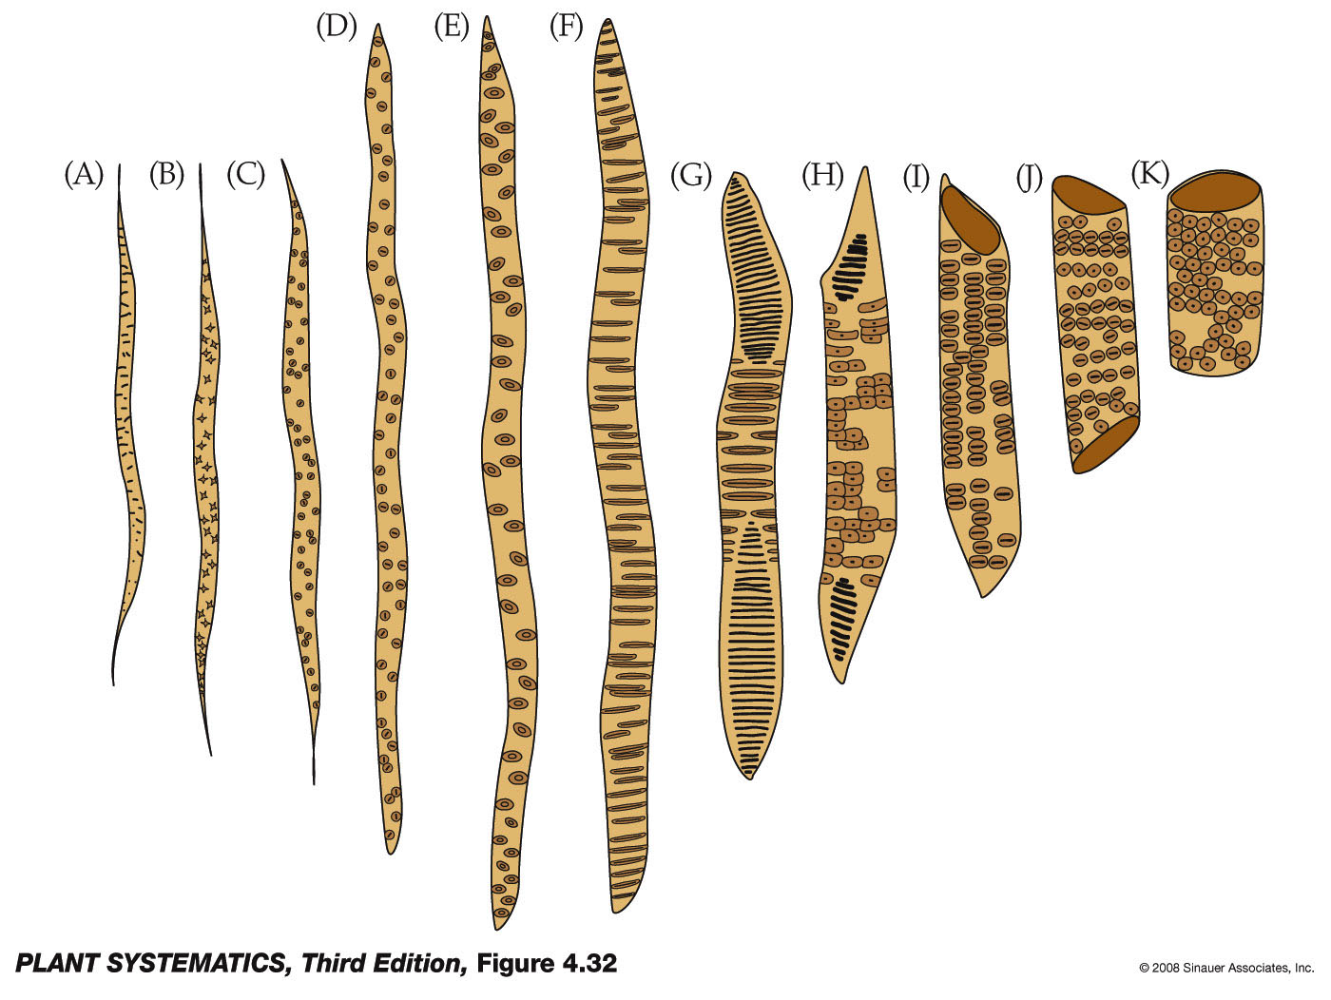
Amborella trichopoda
Vessel elements NO!
Tracheids yes!

Slide 15
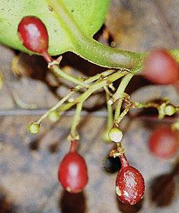
Amborella trichopoda: other distinctive features
Fruit (Yes, our first plant with a fruit!!) is an ovoid red drupe
“More or less inaperturate pollen” J&C pg. 233
Both insect and wind pollinated
Drupes are dispersed by birds

Slide 16
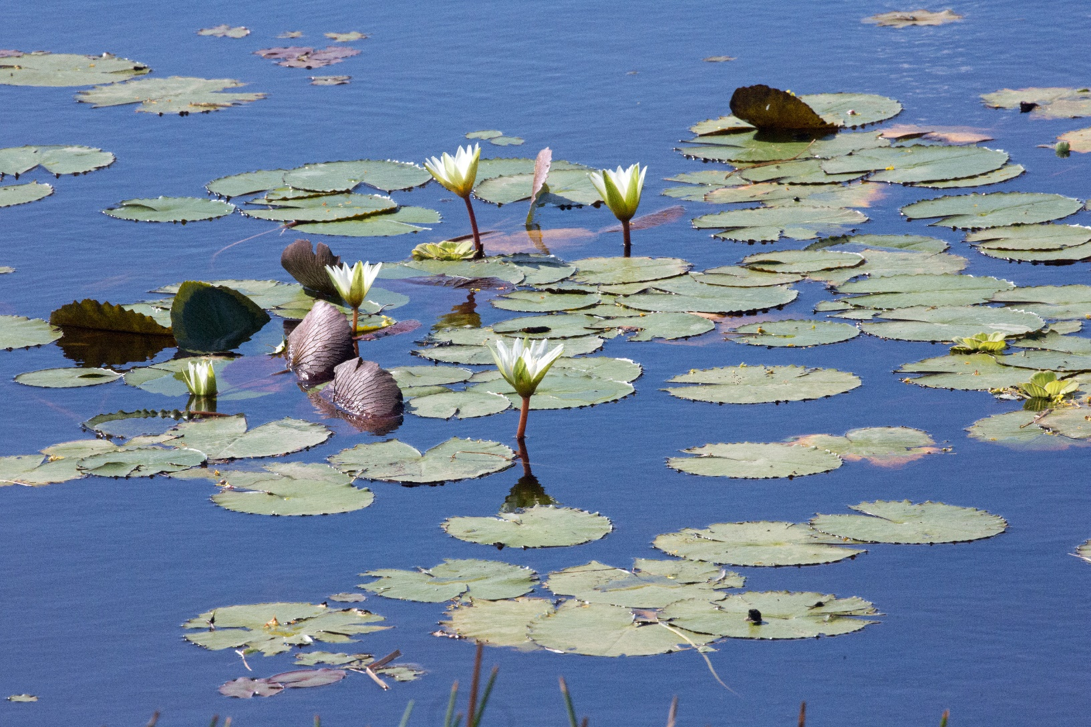
Nymphaeales: Water Lillies

Slide 17
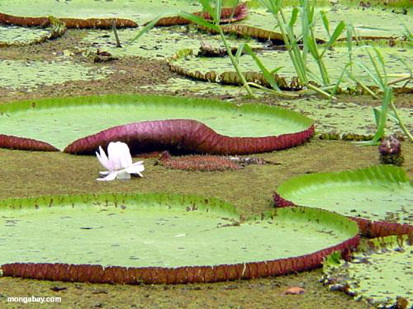

Slide 18
Nymphaeles: Water Lillies
Either lack vessels or have intermediate tracheid-like vessel.
Tepals
Stems with conspicuous air canals
Aquatic
Tepals seem to intergrade with stamens
Stamens sometimes poorly differentiated into anther and filament

Slide 19
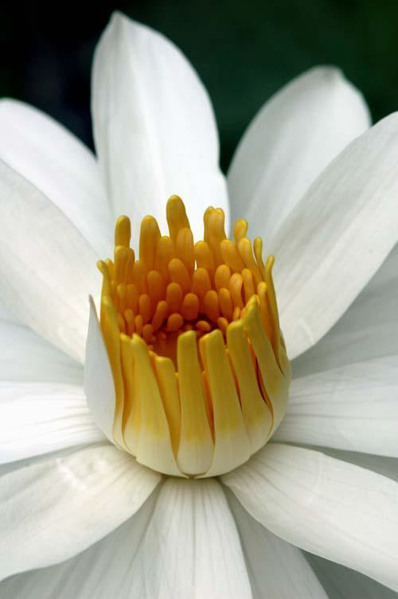
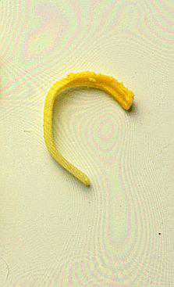
Stamens
Stamen poorly differentiated into filament and anther
Petals seem to intergrade into stamens

Slide 20
Nymphaeles: Water Lillies
Pollen grains usually monosulcate
Carpels distinct or connate
Some flowers attract beetles by producing heat (!) along with a strong fruity odor, flowers opening and closing daily to trap the beetles
4 cell/4 nucleus female gametophyte and diploid endosperm!

Slide 21
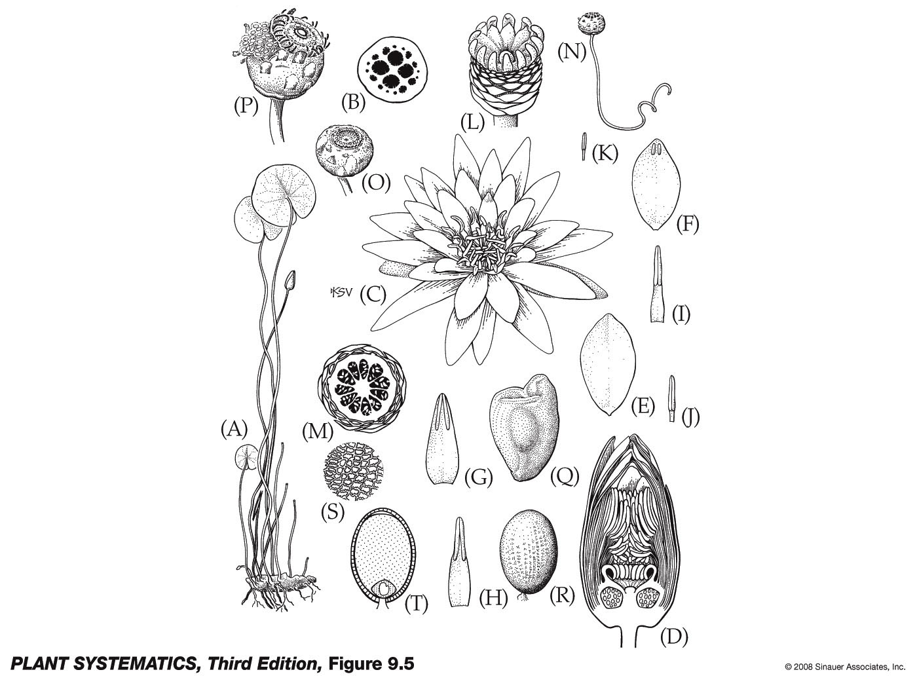
Nymphaceae: Nymphaea odorata
(F-H) Petal-like stamens
(E) Petal
Petals seem to intergrade into stamens

Slide 22
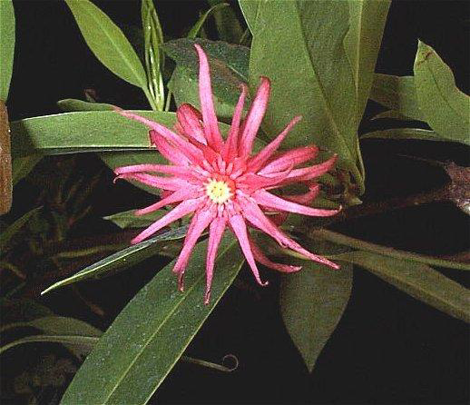
Austrobaileyales (Star Anise Group)
(includes Illiciaceae, Austrobaileyaceae and Trimeniacae
Illicium

Slide 23
Illiciaceae
Stamens still poorly differentiated into filament and anther
Vessel elements clearly present
Tepals still present
Fruit a star-like aggregate of 1-seeded follicles
Endosperm diploid
Pollen grains with 3 (or 6) colpi=furrows!! -- a feature that leads to the Eudicot clade

Slide 24

Illiciaceae
Poorly differentiated stamens
Poorly differentiated stigma and style

Slide 25

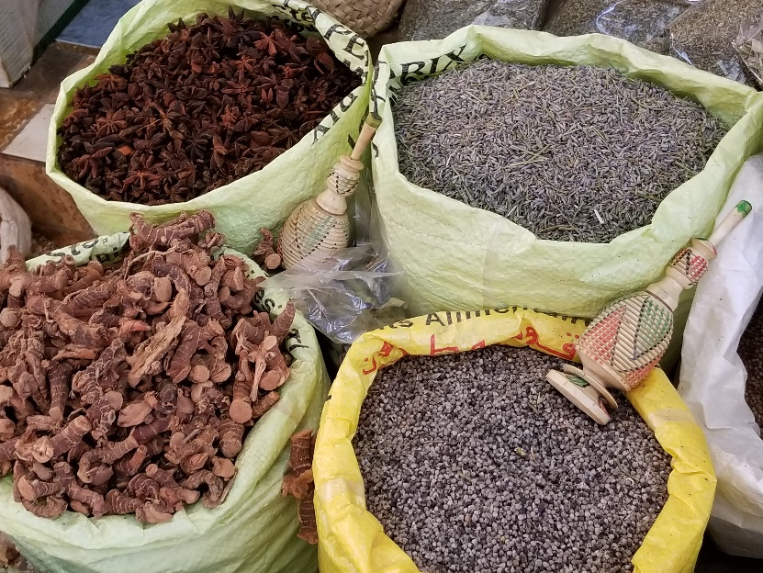
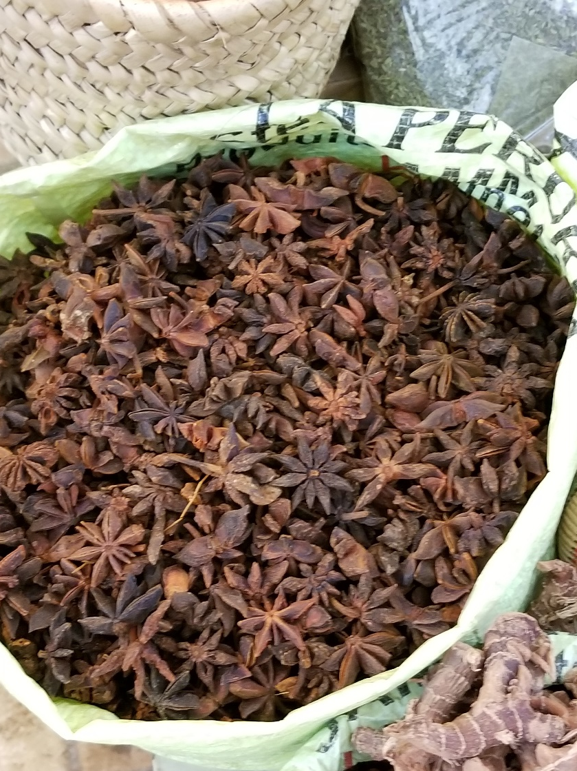
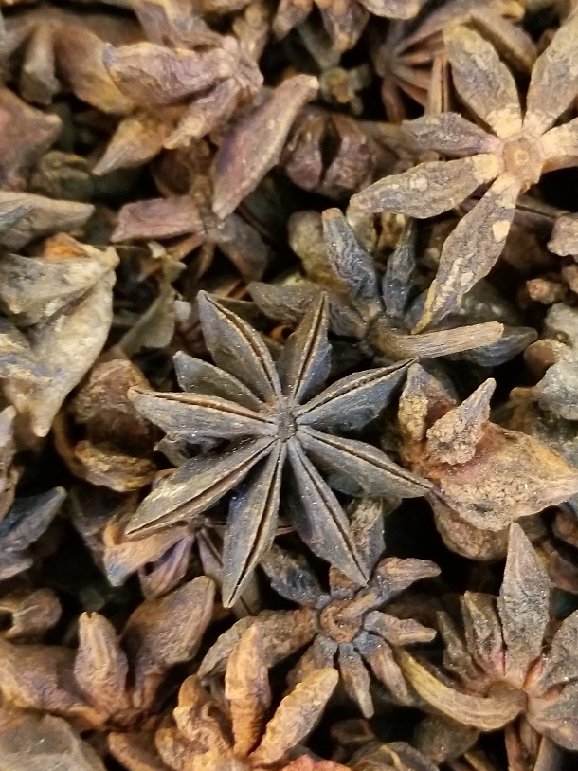
Star Anise– an Aggregate of follicles
The medina (old inner city) at Tangier, Morocco
About 90% of the world's star anise crop is used for extraction of shikimic acid, a chemical intermediate used in the synthesis of oseltamivir (Tamiflu)

Slide 26
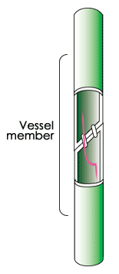
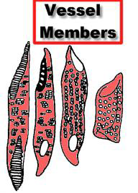
Vessel Members Clearly Present

Slide 27
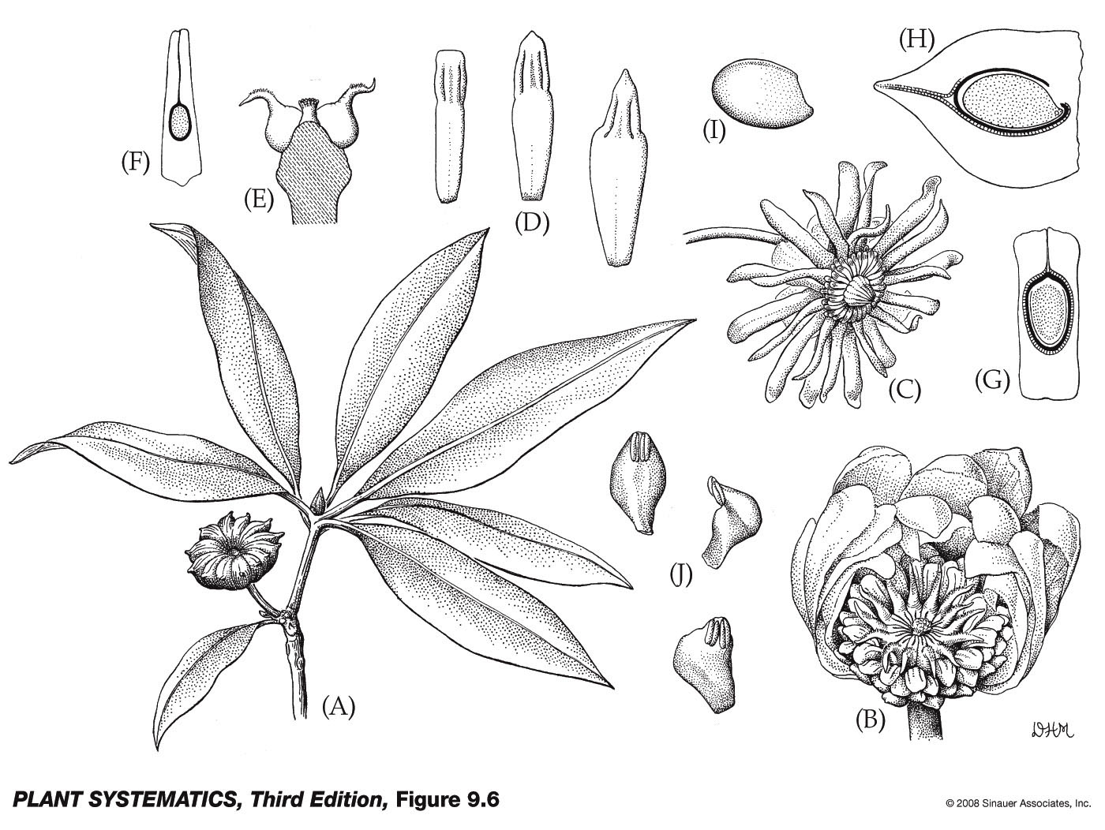
Petaloid stamens

Slide 28
Next stop, Magnoliids !!!!!
Evolutionary advantage to columellate pollen– can expand and contract with changes in humidity and therefore extend life of pollen grain.
You are here!

